Slide 1
“What is a paginable… is that even a thing?”
A Brief Introduction to PaginableCollections
@neekgreen | Nicholas Myers

Slide 2
PaginableCollections is a set of abstractions and extensions created to provide developers with a consistent way to paginate their data.

Slide 3
{ 2, 4, 5, 1, 6, 8, 2, 0, 4, 3, 4, 1, 5, 9, 7, 0, 2, 4, 8, 9 }

Slide 4
{ 2, 4, 5, 1, 6, 8, 2, 0, 4, 3, 4, 1, 5, 9, 7, 0, 2, 4, 8, 9 }

Slide 6
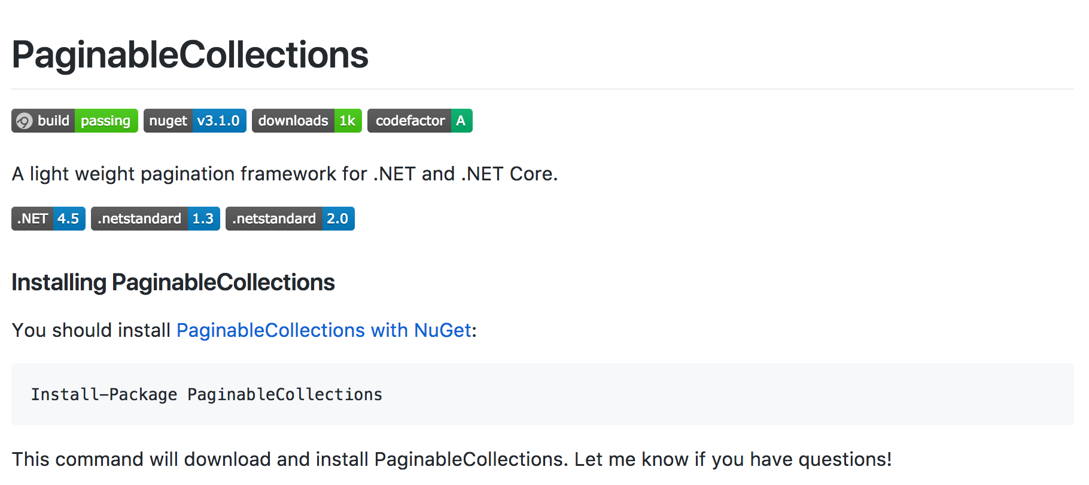

Slide 7
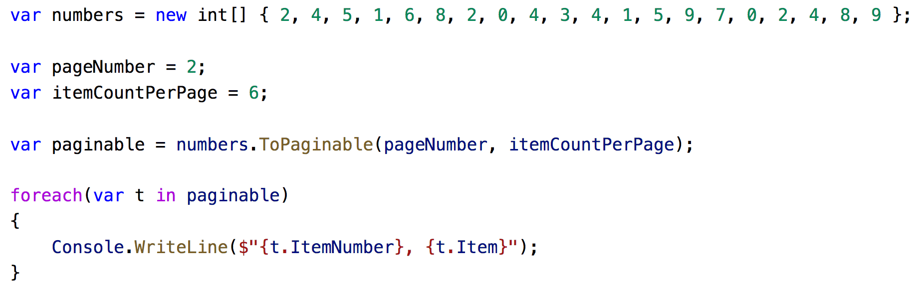

Slide 10
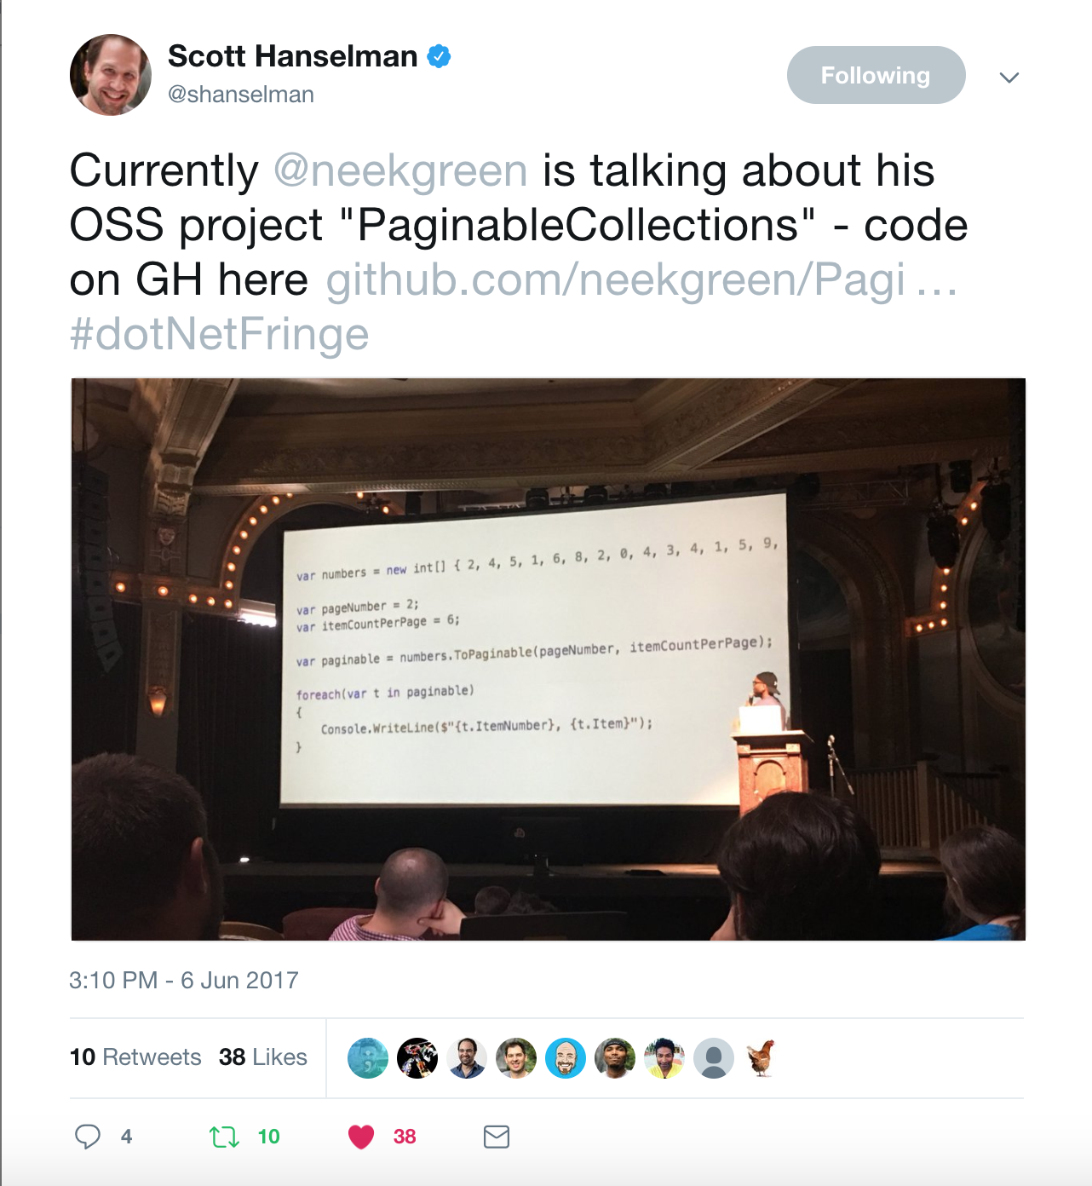
“What is a paginable…
is that even a thing?”
- Scott Hanselman

Slide 11
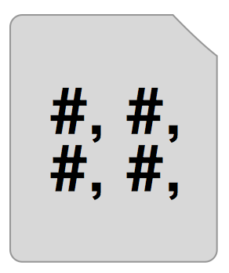
paginable = enumerable + [ page metadata ]
PageNumber
ItemCountPerPage
TotalItemCount
TotalPageCount

Slide 12
IPaginable<T>
paginable = enumerable + [ page metadata ]
IEnumerable<IPaginableItem<T>>

Slide 13
IPaginableItem<T> = Item + [ item metadata ]
ItemNumber
PageNumber
ItemCountPerPage

Slide 15
paginable = enumerable + [ page metadata ]
PageNumber
ItemCountPerPage
TotalItemCount
TotalPageCount

Slide 17
Items
ItemCountPerPage
Pager*
ItemNumber
TotalItemCount
PageNumber

Slide 18
{ 2, 4, 5, 1, 6, 8, 2, 0, 4, 3, 4, 1, 5, 9, 7, 0, 2, 4, 8, 9 }

Slide 19
{ #, #, #, #, #, #, #, #, #, #, #, #, #, #, #, #, #, #, #, # }

Slide 21
http://bit.ly/bhamdotnet
@neekgreen | Nicholas Myers

